Slide 1



Slide 2
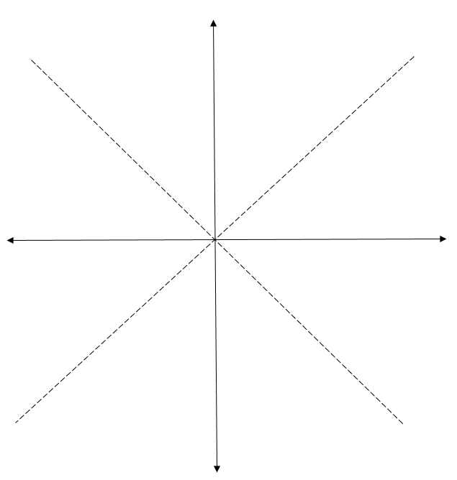
Zone 1
(0,r)
(0,0)

Slide 3
Zone 1
(0,r)
(0,0)

Slide 4
Zone 1
x<y
x=y
(0,r)
x>y
Zone 0
(0,0)

Slide 5

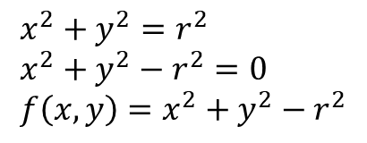
$$x^{2}+y^{2}=r^{2} \\ x^{2}+y^{2}−r^{2}=0 \\ f\left(x,y\right)=x^{2}+y^{2}−r^{2}$$

Slide 6
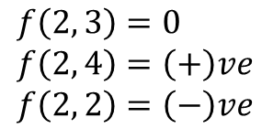
(2, 4)
$$f\left(2, 3\right)=0 \\ f\left(2, 4\right)=\left(+\right)ve \\ f\left(2, 2\right)=\left(−\right)ve$$
(2, 3)
(2, 2)

Slide 7


$$M_{1}$$
$$M_{2}$$

Slide 8
$$f\left(M\right)is positive. M is outside the circle$$

Slide 9
$$f\left(M\right)is negative. M is inside the circle$$

Slide 10
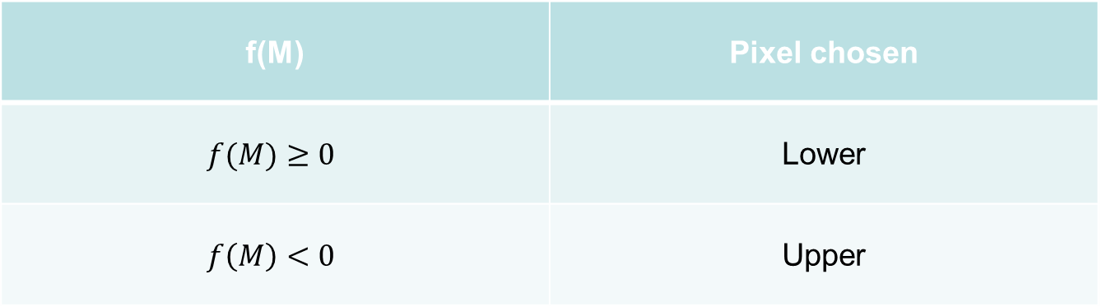
f(M) | Pixel chosen
$$f(M)≥0$$ | Lower
$$f\left(M\right)<0$$ | Upper

Slide 11








$$(x_{p}, y_{p})$$
$$E(x_{p}+1, y_{p})$$
$$(x_{p}+2, y_{p})$$
$$M(x_{p}+1, y_{p}−0.5)$$
$$E_{1}(x_{p}+2, y_{p}−1)$$
$$SE(x_{p}+1, y_{p}−1)$$
$$M_{1}(x_{p}+2, y_{p}−1.5)$$
$$SE_{1}(x_{p}+2, y_{p}−2)$$

Slide 12
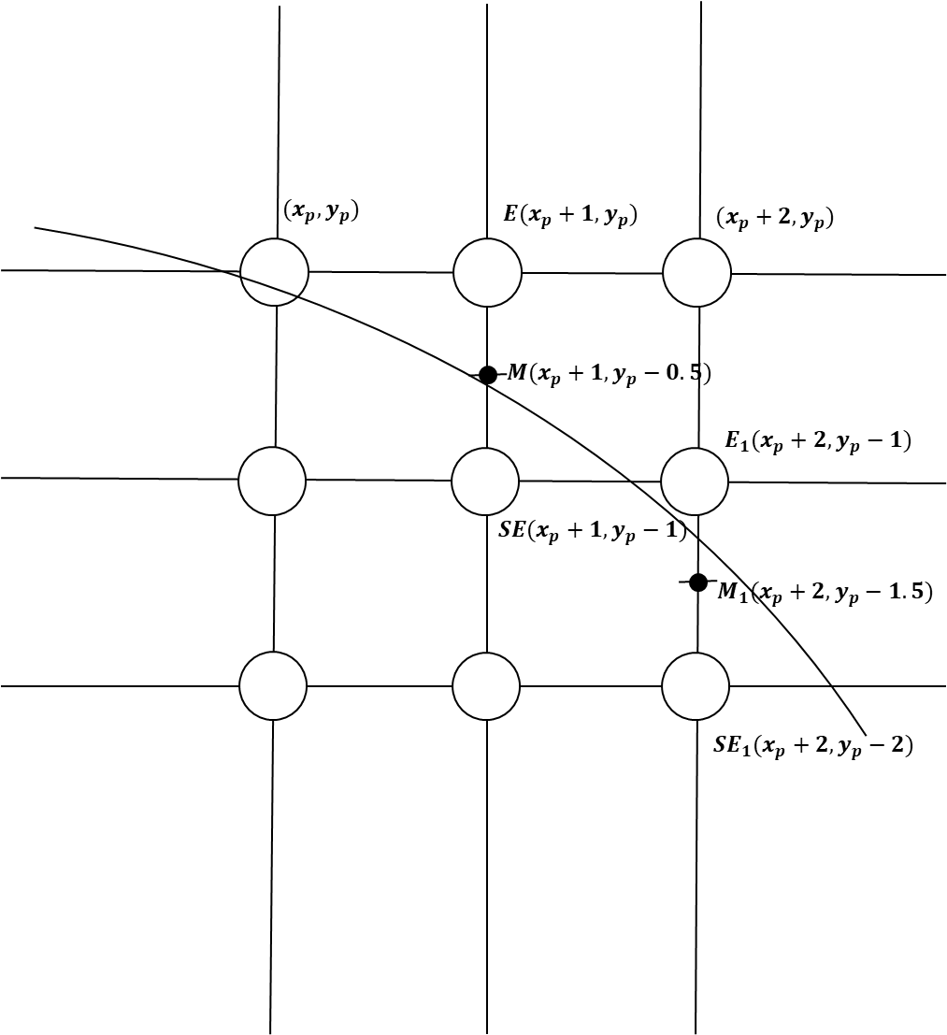
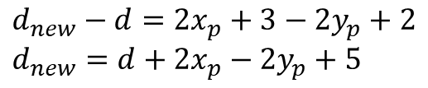
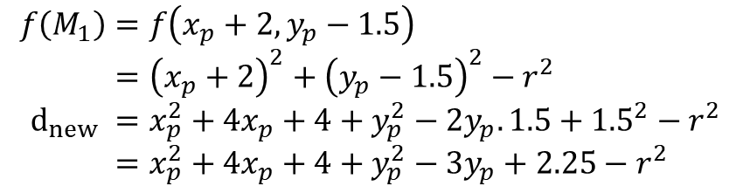
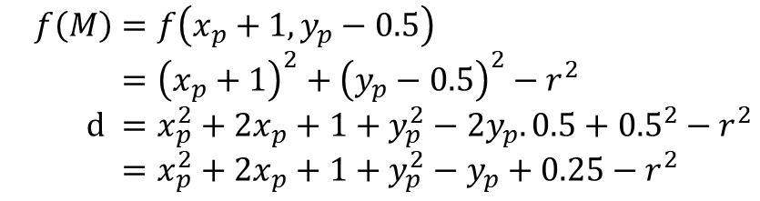

$$f\left(M\right)=f\left(x_{p}+1, y_{p}−0.5\right) \\ ={\left(x_{p}+1\right)}^{2}+{\left(y_{p}−0.5\right)}^{2}−r^{2} \\ d =x_{p}^{2}+2x_{p}+1+y_{p}^{2}−2y_{p}.0.5+{0.5}^{2}−r^{2} \\ =x_{p}^{2}+2x_{p}+1+y_{p}^{2}−y_{p}+0.25−r^{2}$$
$$d≥0, so SE is chosen$$
$$f\left(M_{1}\right)=f\left(x_{p}+2, y_{p}−1.5\right) \\ ={\left(x_{p}+2\right)}^{2}+{\left(y_{p}−1.5\right)}^{2}−r^{2} \\ d_{new} =x_{p}^{2}+4x_{p}+4+y_{p}^{2}−2y_{p}.1.5+{1.5}^{2}−r^{2} \\ =x_{p}^{2}+4x_{p}+4+y_{p}^{2}−{3y}_{p}+2.25−r^{2}$$
$$d_{new}−d=2x_{p}+3−2y_{p}+2 \\ d_{new}=d+2x_{p}−2y_{p}+5$$

Slide 13
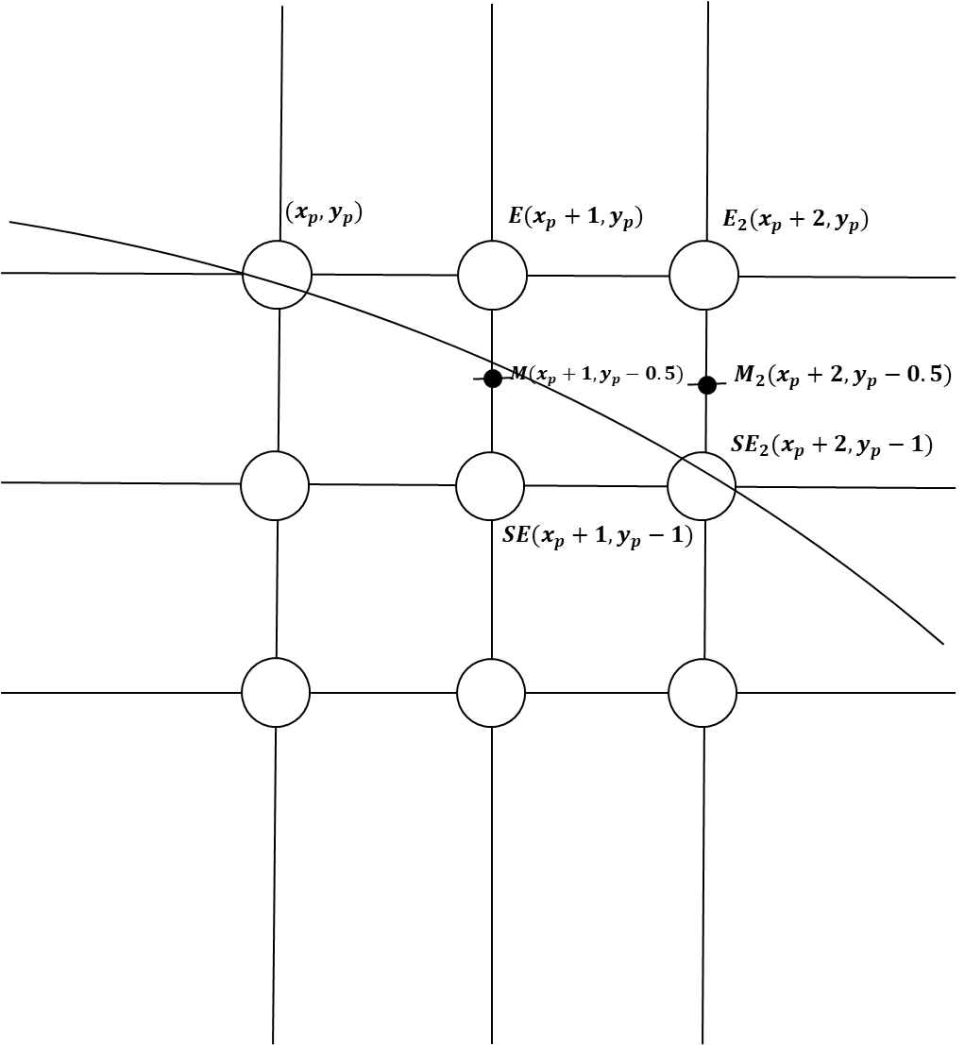

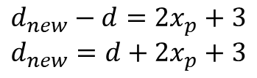
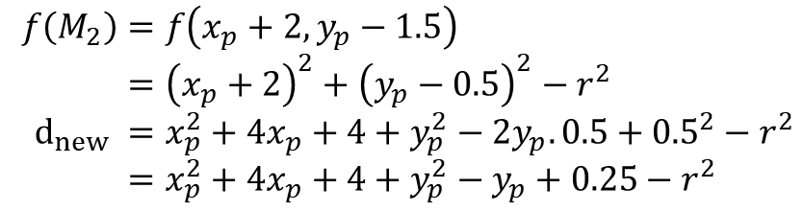
$$f\left(M\right)=f\left(x_{p}+1, y_{p}−0.5\right) \\ ={\left(x_{p}+1\right)}^{2}+{\left(y_{p}−0.5\right)}^{2}−r^{2} \\ d =x_{p}^{2}+2x_{p}+1+y_{p}^{2}−2y_{p}.0.5+{0.5}^{2}−r^{2} \\ =x_{p}^{2}+2x_{p}+1+y_{p}^{2}−y_{p}+0.25−r^{2}$$
$$d<0, so E is chosen$$
$$f\left(M_{2}\right)=f\left(x_{p}+2, y_{p}−1.5\right) \\ ={\left(x_{p}+2\right)}^{2}+{\left(y_{p}−0.5\right)}^{2}−r^{2} \\ d_{new} =x_{p}^{2}+4x_{p}+4+y_{p}^{2}−2y_{p}.0.5+{0.5}^{2}−r^{2} \\ =x_{p}^{2}+4x_{p}+4+y_{p}^{2}−y_{p}+0.25−r^{2}$$
$$d_{new}−d=2x_{p}+3 \\ d_{new}=d+2x_{p}+3$$

Slide 14
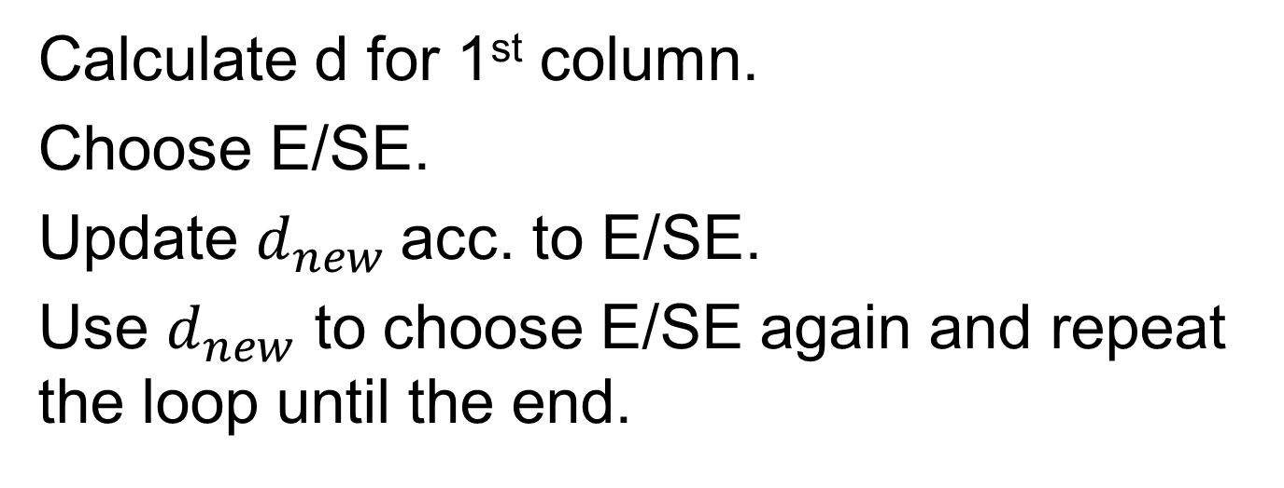
Calculate d for 1st column.
Choose E/SE.
Update $d_{new}$acc. to E/SE.
Use $d_{new}$ to choose E/SE again and repeat the loop until the end.

Slide 15


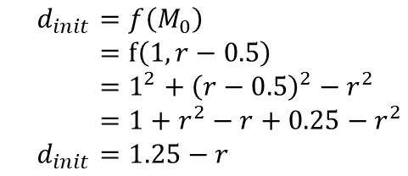
$$(0, r)$$
7
$$d_{init}=f\left(M_{0}\right) \\ =f\left(1, r−0.5\right) \\ =1^{2}+{\left(r−0.5\right)}^{2}−r^{2} \\ =1+r^{2}−r+0.25−r^{2} \\ d_{init}=1.25−r$$
$$M_{0}(1,r−0.5)$$
6
5
4
3
2
0
1
2
3
4
5
6
7

Slide 16

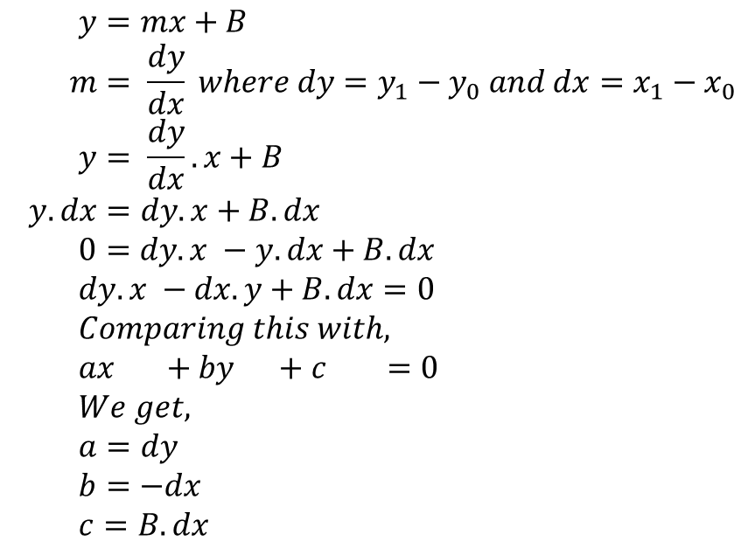



$$(x_{1},y_{1})$$
$$y=mx+B \\ m= \frac{dy}{dx} where dy=y_{1}−y_{0} and dx=x_{1}−x_{0} \\ y= \frac{dy}{dx}.x+B \\ y.dx=dy.x+B.dx \\ 0=dy.x −y.dx+B.dx \\ dy.x −dx.y+B.dx=0 \\ Comparing this with, \\ ax +by +c =0 \\ We get, \\ a=dy \\ b=−dx \\ c=B.dx$$
$$dy=y_{1}−y_{0}$$
$$(x_{0},y_{0})$$
$$dx=x_{1}−x_{0}$$

Slide 17




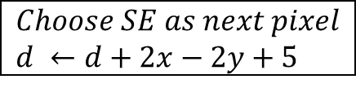
$$d=d_{init} \\ =1.25−r$$
$$is d≥0?$$
yes
no
$$Choose SE as next pixel \\ d ←d+2x−2y+5$$
$$Choose E as next pixel \\ d ←d+2x+3$$
$$Check if x>y$$
no
yes
end

Slide 18
r | 1.25-r | 1-r
1 | 0.25, (+)ve | 0, (+)ve
2 | -0.75, (-)ve | -1, (-)ve
3 | -1.75, (-)ve | -2, (-)ve
4 | -2.75, (-)ve | -3, (-)ve
5 | -3.75, (-)ve | -4, (-)ve
Using 1-r would be same as using 1.25-r as starting value of d

Slide 19

$$d=d_{init} \\ =1−r$$
$$is d≥0?$$
yes
no
$$Choose SE as next pixel \\ d ←d+2x−2y+5$$
$$Choose E as next pixel \\ d ←d+2x+3$$
$$Check if x>y$$
no
yes
end

Slide 20
Algorithm
func MidpointCircle(int radius, int value){
int x, y, d;
d = 1 - radius;
x = 0;
y = radius;
Circlepoints(x, y, value);
while (x < y) {
if (d < 0) {
//choose E
d = d + 2*x + 3;
x = x + 1;
}
else {
//choose SE
d = d + 2*x – 2*y + 5;
x = x + 1;
y = y - 1;
}
Circlepoints(x,y, value)
}
}

Slide 21
void Circlepoints(int x, int y, int value){
WritePixel (x, y, value);
WritePixel (y, x, value);
WritePixel (y, —x, value);
WritePixel (x, —y, value);
WritePixel (—x, —y, value);
WritePixel (—y,—x, value);
WritePixel (—y, x, value);
WritePixel (—x, y, value);
}
(-x,y)
(x,y)
(-y, x)
(y, x)
(y,-x)
(-y, -x)
(-x,-y)
(x,-y)

